Slide 1
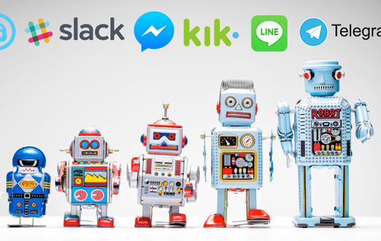
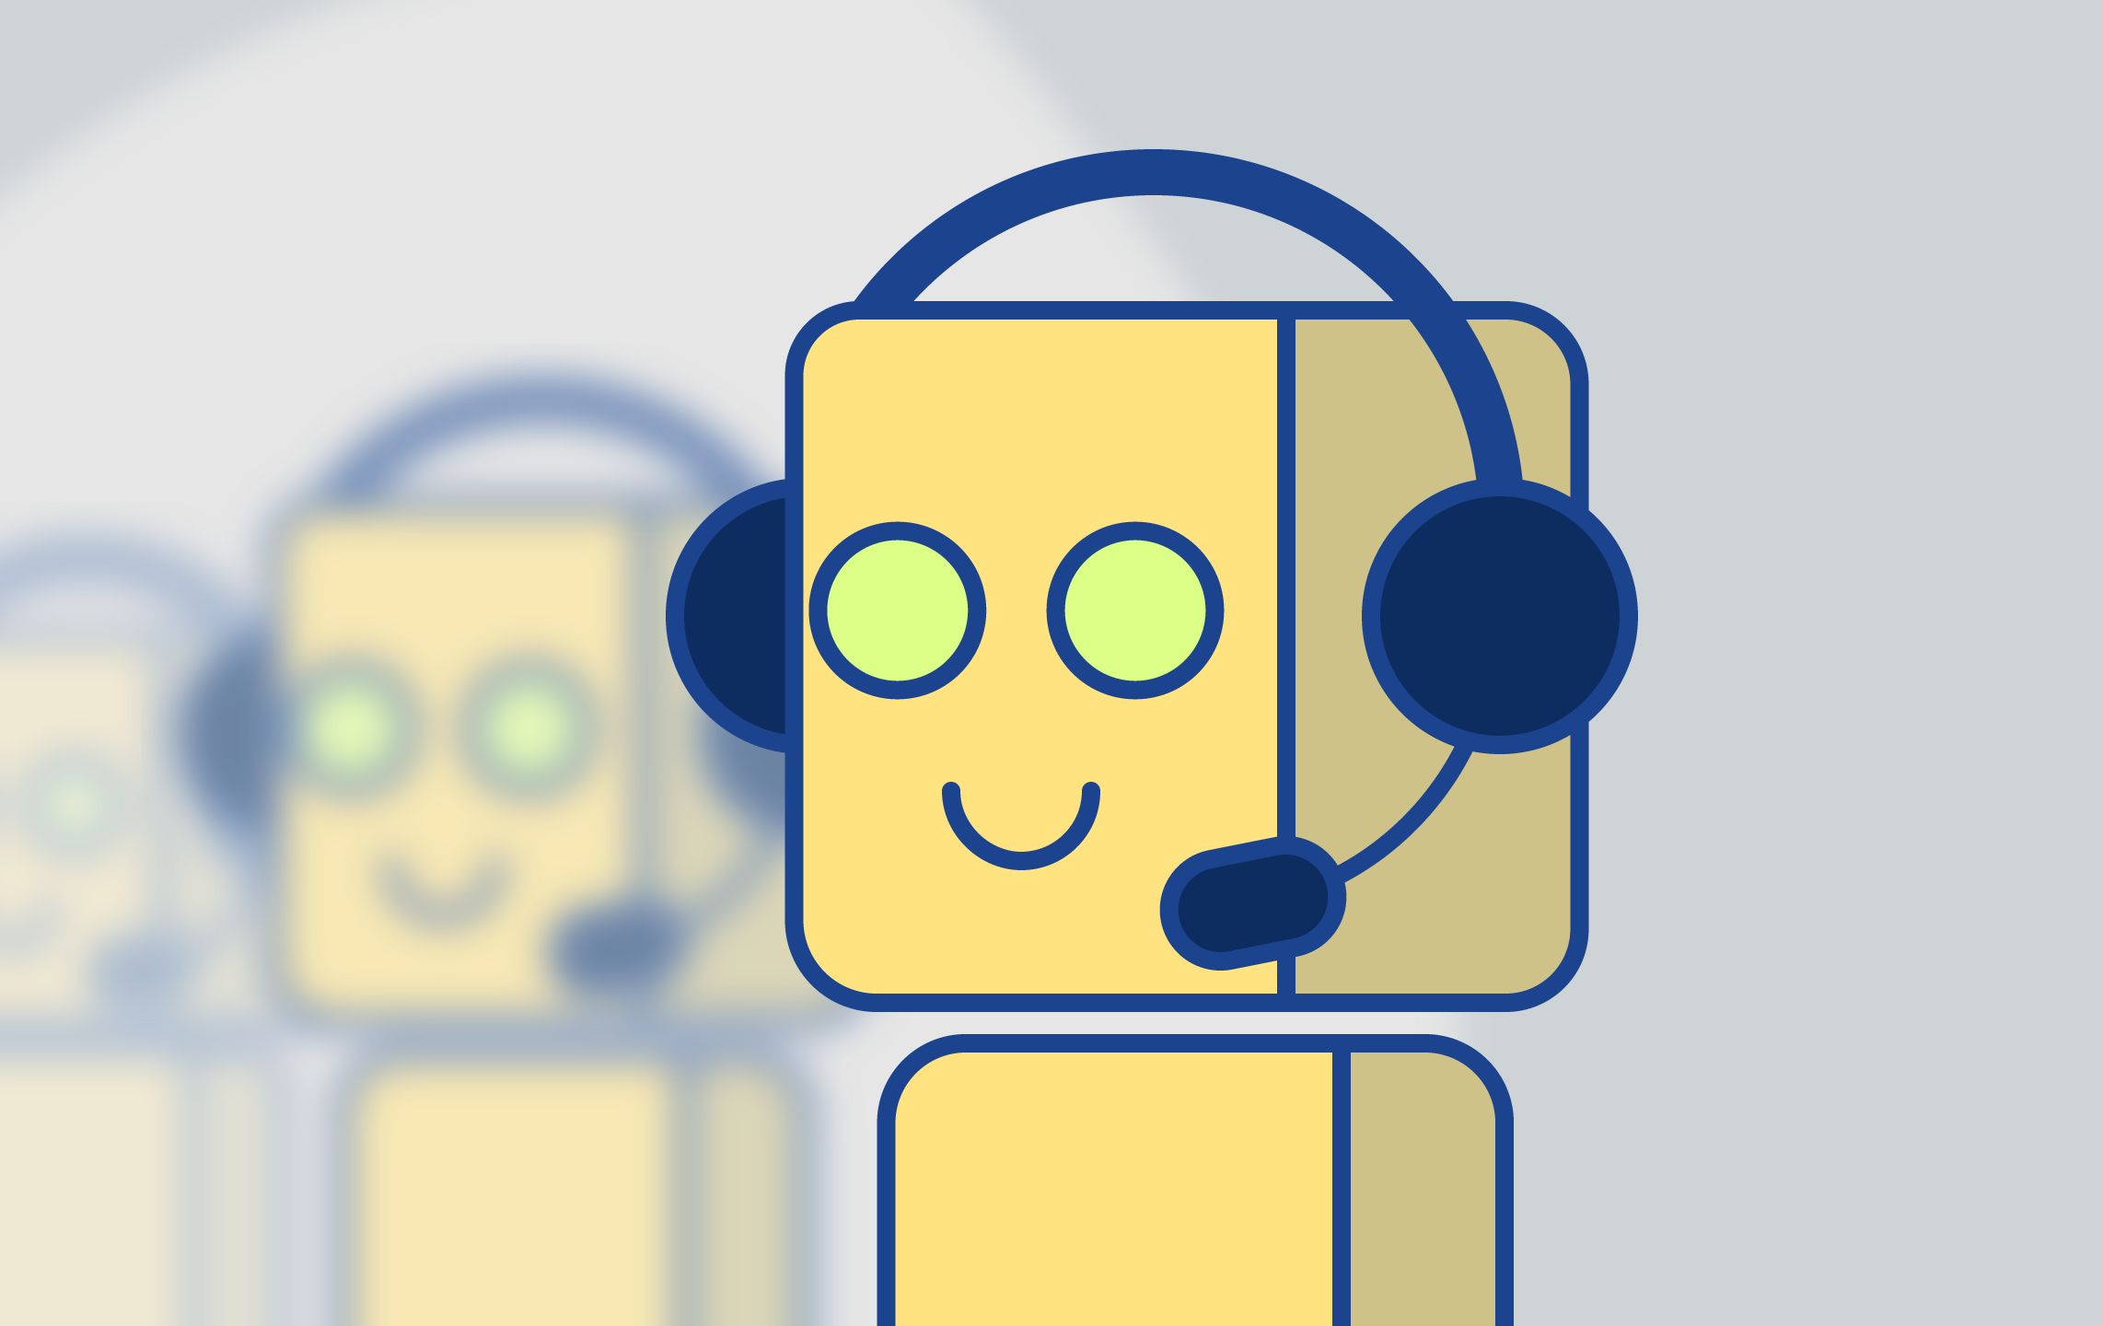
CHATBOTS
https://ravitha.github.io/
Notes:
Chatbots have become a buzz word in every industry as they are offering more value to businesses to improve the functionary
Chatbots are a piece of software which conducts conversation in oratorial (or) textual manner
Chatbots are new revolution for customer service reducing the impact on humans and helping buisness in saving a significant amount of money and time

Slide 2
Questions
What are Chatbots
01
What they are useful for
02
How to create bots
03
What technology do they use
04
Notes:
Agenda of my presentation is to provide a birds eye view of chatbots
What are bots?
What value do they offer to businesses?
What technology they use?
How do develop one such bot?

Slide 3

CHAT + BOT
Realtime exchange of messages
A computer program designed to simulate conversation with human users, especially over the Internet.
ROBOT – Autonomous program on a network
Notes:
To understand what is a chatbot. Let us analyze the key terms in it : chat and bot
Chat denotes kind of informal communication online with one or more simultaneous users
Robot is an autonomous program (which acts without the intervention of the user)

Slide 4

Conversational Interfaces
Device (or) software which enables the user to interact with the bot
establishing conversation
They are not mere text based interfaces
Notes:
Conversational interfaces are the mode of interaction between the human and the bot.
Design of conversational UI plays an important role in the effectiveness of the chatbot.
Traditional mode of interaction was through text.
Why chatbots are considered important these days ? We find the traditional GUI based model to accomplish tasks unsatisfactory
Chatbots are being increasingly used in sales and marketing apart from their standard customer support

Slide 5
Conversational UI Example
E.g. “I would like to reserve a cargo van for 1 pm this Friday”. This statement essentially combines a bunch of procedural steps together.
Q: “What would you like to do?”, A: “Make a reservation”
Q: “What would you like to reserve?”, A: “A cargo van”
Q: “What day would you like to reserve it for?“, A: “Friday”
Q: “At what time?“, A: “1 pm”
Notes:
When we say conversational interfaces, it is implicit that both the involving parties have some knowledge on the ideas communicated
Conversational UI should be intelligent enough to understand the context from the input statements.
Accomplishing a task using single statement is obviously better than procedural (or) scripted model.
In procedural model, chatbot understand the context from the responses of the user to predetermined set of questions

Slide 6
DESIGNING CONVERSATIONAL Ui
Domain knowledge: What does a user expect this bot to understand?
Personality: What tone or vocabulary does the bot employ?
ELIZA
Therapy Session
Rogerian Therapist
Notes:
While designing a conversational UI, Fundamental Design Question involves identification of the domain knowledge and associating a personality to the bot
Domain Knowledge – What for it is created?
Watson – Understand facts and construct responses
Slackbot – helps the users to set their accounts

Slide 7



Platforms
High
Messenger Platforms
Facebook Messenger
Slack
Phone Calls (or) Voice based systems
Alexa
Google Assistant
SMS (Short Messaging Service)
Low
Notes:
Platform here denotes the development environment
It is based on the target medium for which software is developed for. The popular target mediums are shown here. They are arranged according to their popularity scale

Slide 8
Evolution of conversational AI
Chatbots
Rule based
Self learning
Retrieval Based
Generative
Scripted Chatbots
Intent Recognizers
Virtual Agents
Human Like Advisor
Uses key phrases in the request and provides a pre-defined response
Machine Learning
Interpret the relationship between the words to understand the request
Can understand the human request
Provide personalized answers
Connects to other systems to leverage the data
It can understand and reason its environment like a human

Slide 9
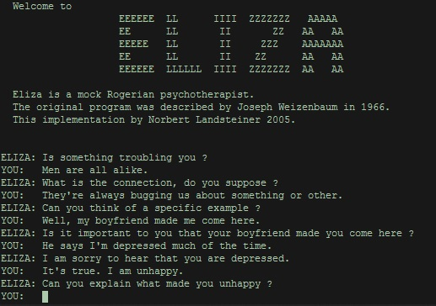
PAST WORKS
Turing Test – 1950
ELIZA – 1966 (MAD-Slip Symmetric List Processor) (IBM 704)
Responses to messages are provided via text based terminal
Most famous implementation of ELIZA is DOCTOR[1]
PARRY – 1970
Jabberwacky – 1988
Dr.Sbaitso - MS-DOS based personal computers
ALICE - 1975
[1] http://psych.fullerton.edu/mbirnbaum/psych101/Eliza.htm

Slide 10
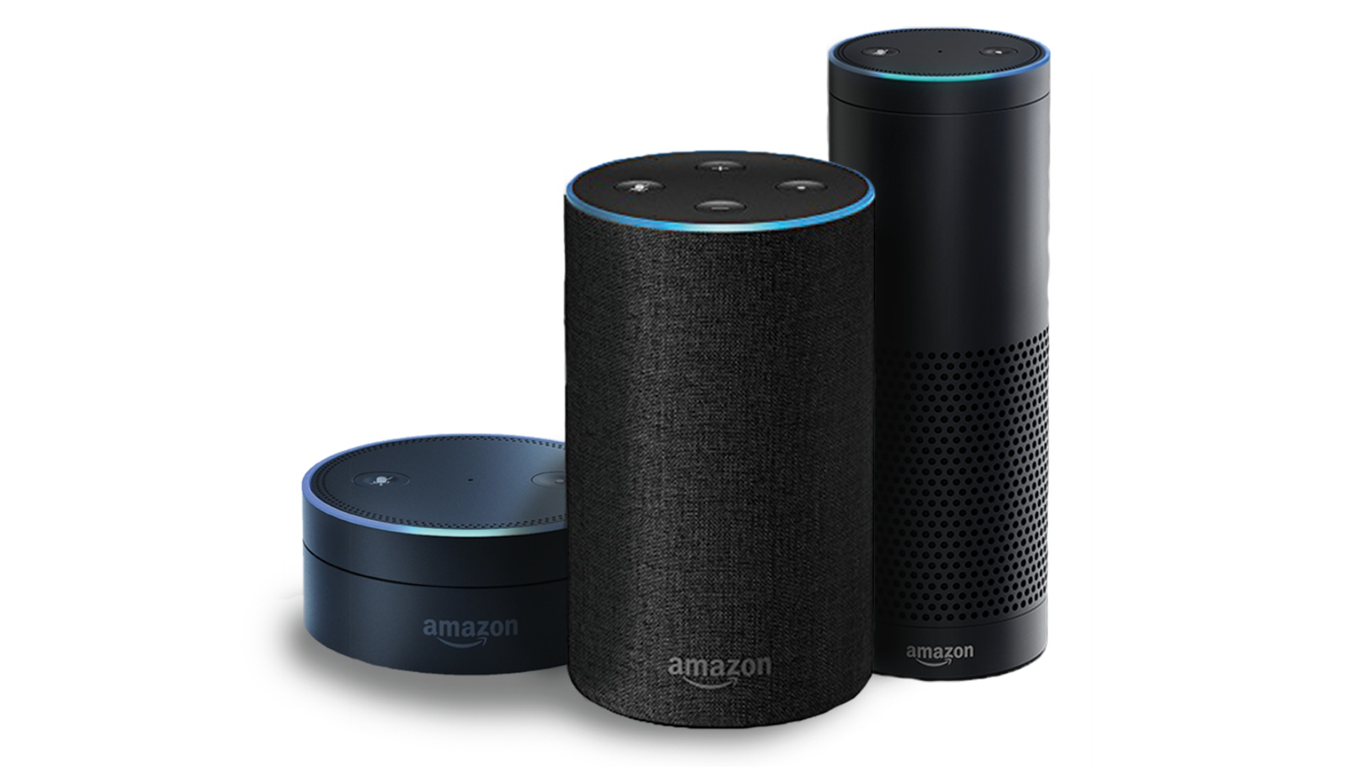
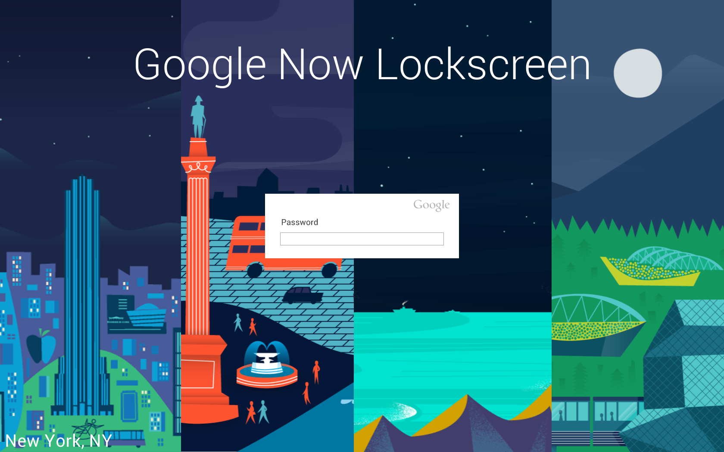
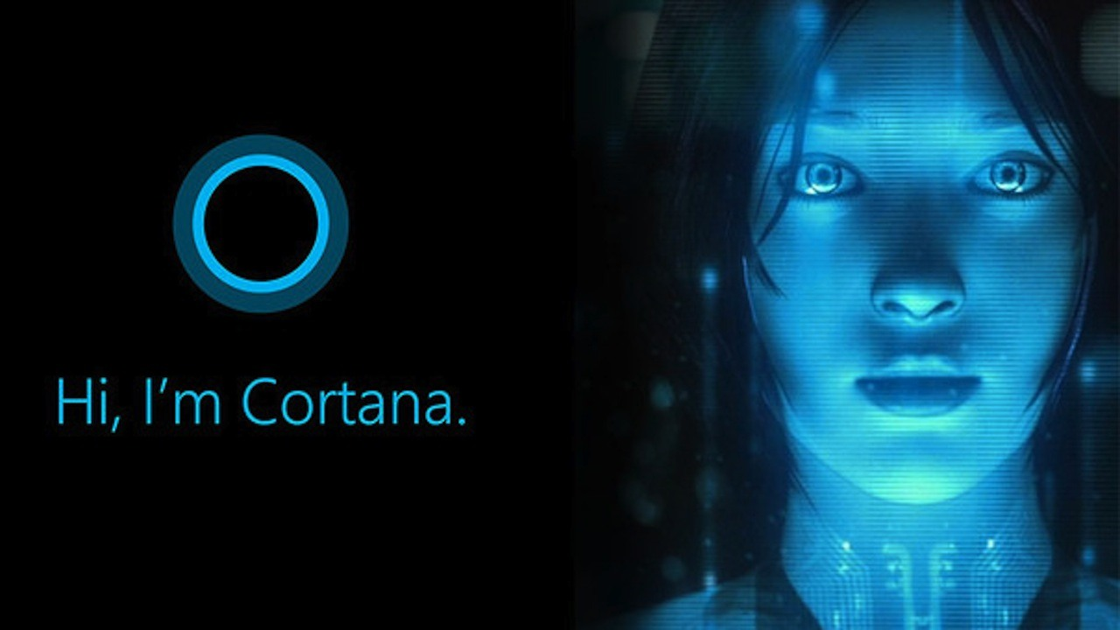
Current trends
Apple Siri – 2011
Google Now – 2012
Microsoft Cortana - 2013
Amazon Alexa – 2014
Google Assistant
Notes:
Problem with Apple Siri is inaccessibility to external services
Alexa and Google Assistant are general assistants that can be used for variety of tasks

Slide 11
SCRIPTED BOTS

Slide 12

SIMPLE BOT
GREETING_KEYWORDS = ("hello", "hi", "greetings", "sup", "what's up",)
GREETING_RESPONSES = ["sup bro", "hey", "*nods*",
"hey you get my snap?"]
def check_for_greeting(sentence):
"""If any of the words in the user's input was a greeting, return
a greeting response"""
for word in sentence.words:
if word.lower() in GREETING_KEYWORDS:
return random. choice(GREETING_RESPONSES)
It searches the user’s utterance for one or more known keywords and returns one of several possible responses.

Slide 13
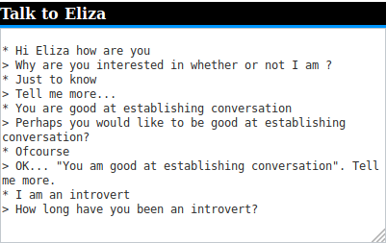
ELIZA
http://psych.fullerton.edu/mbirnbaum/psych101/Eliza.htm

Slide 14
Eliza implementation
User Input
Rules
Mapping (IP to OP)
Responses
Regular Expressions
Match messages against known patterns
Extract Key phrases
Transform Sentences Grammatically (Conjugative verbs)
https://dhconnelly.com/paip-python/docs/paip/eliza.html

Slide 15
Match messages against known patterns
def match_rule(rules, message): response, phrase = "default", None # Iterate over the rules dictionary for pattern,responses in rules.items(): # Create a match object match = re.search(pattern, message) if match is not None: response = random.choice(responses) # Choose a random response if '{0}' in response: phrase = match.group(1) # Return the response and phrase return response, phrase
Rules
Pattern | Responses
If (.*) | Do you really think its likely that {0} What do you think about {0} Really- if{0}
Do you think (.*) | If{0}?Absolutely. No chance
I want (.*) | Why do you want {0} What's stopping you from getting {0} What would it mean if you got {0}
Do you remember (.*) | Did you think I would forget{0} Why haven't you been able to forget{0} What about {0} Yes.. And ?

Slide 16
Grammatical Transformation
def replace_pronouns(message): message = message.lower() if 'me' in message: # sub method replace the occurence of str1 with str2 in the given message message = re.sub('me','you',message) return message if 'my' in message: message = re.sub('my','your',message) return message if 'your' in message: message = re.sub('your','my',message) return message if 'you' in message: message = re.sub('you','me',message) return message return message

Slide 17
Complete model
If default, random selection of standard reponses
Input Text
Response
Match Rule
Compile Response
Reply
Key phrase
Grammatical Transformation

Slide 18
INTENT RECOGNIZERS

Slide 19
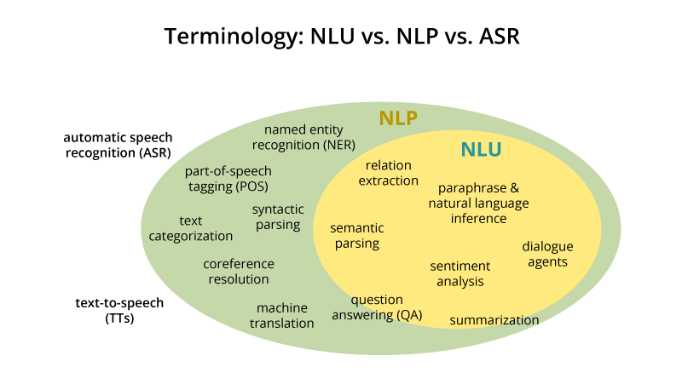
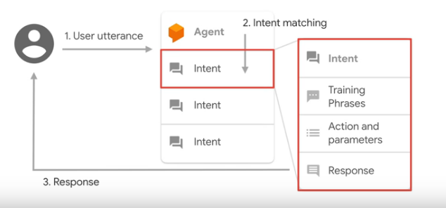
Natural Language UNDERSTANDING
Human Language
Computer Understandable format
Notes:
Natural Language Processing is sub-field of AI acts as an integral component in the conversion of natural language into computer understandable format.
Natural Language Understanding is a sub field of NLP which uses the machine learning techniques to identify the intent of the user utterance (Command) and entities involved in the utterance.

Slide 20
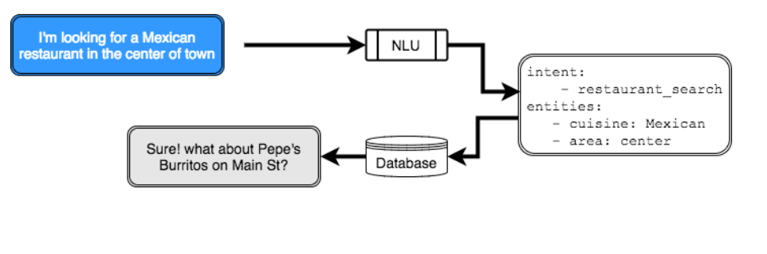
Intent: An intent represents the purpose of a user's input.
Entity: An entity represents a term or object that is relevant to your intents and that provides a specific context for an intent.
Dialog: A dialog is a branching conversation flow that defines responses to the defined intents and entities.

Slide 21
Atis dATASET
Sample Utterances | Intent
BOS what is the arrival time in san francisco for the 755 am flight leaving washington EOS | flight_time
BOS find me the earliest flight from boston to atlanta EOS | flight
BOS what kinds of planes are used by american airlines EOS | aircraft
BOS please show me round trip tickets from denver to oakland EOS | airfare
This data set contains 4978 train and 893 test spoken utterances (text) classified into one of 26 intents.
Notes:
GloVe is an unsupervised learning algorithm for obtaining vector representations for words. Training is performed on aggregated global word-word co-occurrence statistics from a corpus, and the resulting representations showcase interesting linear substructures of the word vector space.

Slide 22

Process flow for intent identification
Sample Globe Vectors | Intent
Training Dataset
Utterances
Glove
Word Vectors
Intent
ML model

Slide 23
Conversion of text into vectors (WORD EMBEDDINGS)
Theory of Distributional Hypothesis states that
Linguistic items with similar distributions (similar context) have similar meanings.
It was really cold yesterday. It will be really warm today, though. It'll be really hot tomorrow! Will it be really cool Tuesday?
According to the Distributional Hypothesis, the words cold, warm, hot and cool must be related in some way (i.e., be close in meaning) because they occur in a similar context, i.e., between the word "really" and a word indicating a particular day. (Likewise, the words yesterday, today, tomorrow and Tuesday must be related, since they occur in the context of a word indicating a temperature.)

Slide 24
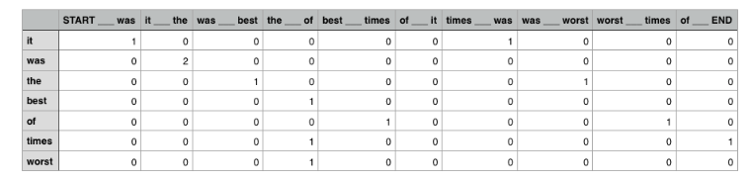
WORD VECTORS FORMED BY COUNTING CONTEXTS
Column – Context
"context" is just the word that precedes and the word that follows.
It was the best of times, it was the worst of times.
Row - Word
Number of times word has appeared in the context

Slide 25
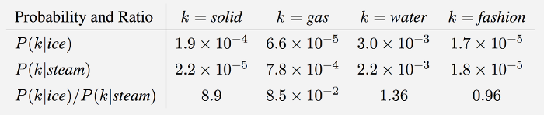
Glove
GloVe is an unsupervised learning algorithm for obtaining vector representations for words.
Training is performed on aggregated global word-word co-occurrence statistics from a corpus, and the resulting representations showcase interesting linear substructures of the word vector space.
The training objective of GloVe is to learn word vectors such that their dot product equals the logarithm of the words' probability of co-occurrence. Owing to the fact that the logarithm of a ratio equals the difference of logarithms, this objective associates (the logarithm of) ratios of co-occurrence probabilities with vector differences in the word vector space.

Slide 26
Analyzing word vectors of glove
To understand the contextual similarity between Glove vectors , cosine similarity measure is used.
Cosine SImilarity measures the difference In the angle between the vectors
1 indicates that the vectors point in the same direction
0 indicates they are perpendicular
-1 indicates they point in opposite directions
Difference between "cricket" and "football"
0.5254916173923929
Difference between "foot" and "football"
0.2559363414015776

Slide 27
Building SUPERVISED MODEL FOR INTENT RECOGNITION
Inference Using nearest neighbor classifier
1. Compute Glove vector for the test sentence – average of glove vectors for every word in the utterance
2. Calculate cosine similarity of test sentence with respect to all tuples in the training dataset
3. Intent for the test sentence will be same as that of intent of training sample with which it had the maximum similarity value
i would like to find a flight from charlotteto las vegas that makes a stop in st. louis
Flight Information

Slide 28
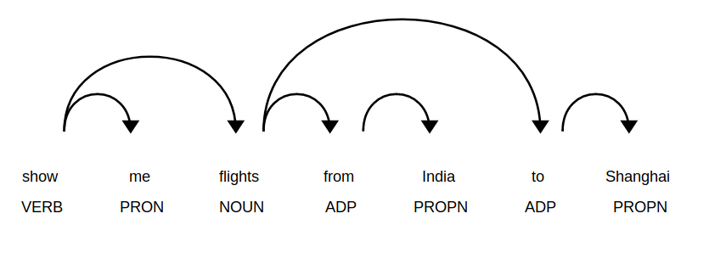
Entity recognition
Keywords may not help in the identification of entities
Contextual clues
Captilaization
Words occuring before & after
Numbers
Dependency parsing to identify the roles

Slide 29
Virtual agents (Creating dialog flow (or) leveraging on existing api)

Slide 30
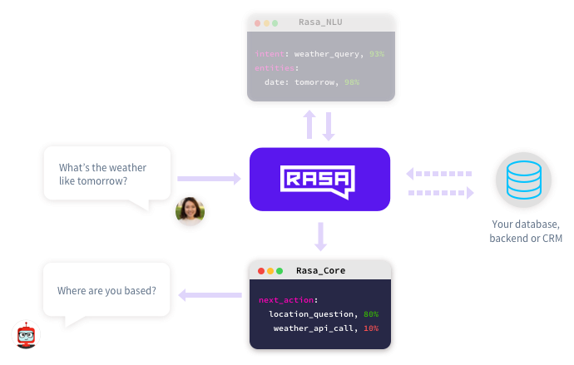

Slide 31
References
1. https://onlim.com/en/the-history-of-chatbots/
2. https://rangle.io/blog/chatbots-an-introduction-to-conversational-ui/
3. https://medium.com/analytics-vidhya/building-a-simple-chatbot-in-python-using-nltk-7c8c8215ac6e
4. https://apps.worldwritable.com/tutorials/chatbot/
5. https://s3.amazonaws.com/assets.datacamp.com/production/course_3631/slides/chapter2.pdf
6. https://nlp.stanford.edu/projects/glove/
7. https://gist.github.com/aparrish/2f562e3737544cf29aaf1af30362f469#file-understanding-word-vectors-ipynb
8. https://github.com/santanu13/Weabot/blob/master/weabot.ipynb

Slide 32

Thanks for listening
Drop in a mail at nrr.it@psgtech.ac.in for queries
Check ravitha.github.io for my works and projects
This Photo by Unknown author is licensed under CC BY-SA.

